Slide 1

https://www.uni-goettingen.de/en/48115.html
UNPLAB-QuGen_Ch-2[Transition I]
1

Slide 2
Sequential Number: #36
UNPLAB-QuGen_Ch-2[Transition I]
Unless I explicitly state otherwise, images and cartoons are created using ChatGPT.
You may use this material free of charge under the terms of the CC BY license. This requires that you provide appropriate attribution to the author: W. Link, University of Goettingen, Germany.
In a few cases, individual images, photographs, or similar material may be subject to a more restrictive Creative Commons license. Where this applies, it is explicitly indicated, and you must comply with the stated license terms for those items.
Please check the license information carefully before reuse. Responsibility for complying with the applicable license terms rests entirely with you.
This symbol usually indicates that a page is rather important
2

Slide 3
You already know:
Population Genetics. Genotype frequency, Allele frequency, Hardy-Weinberg-Equilibrium, Inbreeding coefficient, Kinship, Selection, Drift, Migration, Mutation. GxE. h².
And you have already studied Recurrent Selection.
You already have seen several Line Breeding Methods, and the other Breeding Categories; and studied phenotypic and genetic correlation between traits.
Keywords of this chapter: Transition from Qualitative traits to Quantitative Traits, from Mendelian segregation and mono- or oligogenic segregation to the infinitesimal concept of Fisher’s genotypic and genetic variance.
Algebra as introduced in this chapter:
U=R · I Voltage „U“ [volts] is Resistance „R“ [ohms] times Current „I“ [amps]
;-)
3

Slide 4
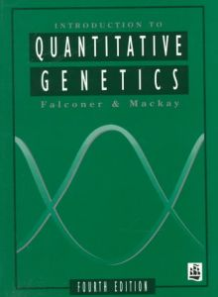
Most agronomically important characters are so-called ‘Quantitative’ traits.
What is meant, what are the difference between these and the Qualitative traits ?
Falconer, D. S., and
T. F. C. Mackay, 1996: Introduction to Quantita-tive Genetics.
Ed 4. Longman, UK
Even traits such as number of fruits per plant or number of offspring per animal (meristic, i.e. countable traits) are usually considered as basically Quantitative traits.

Slide 5
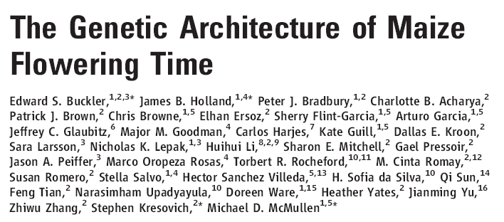
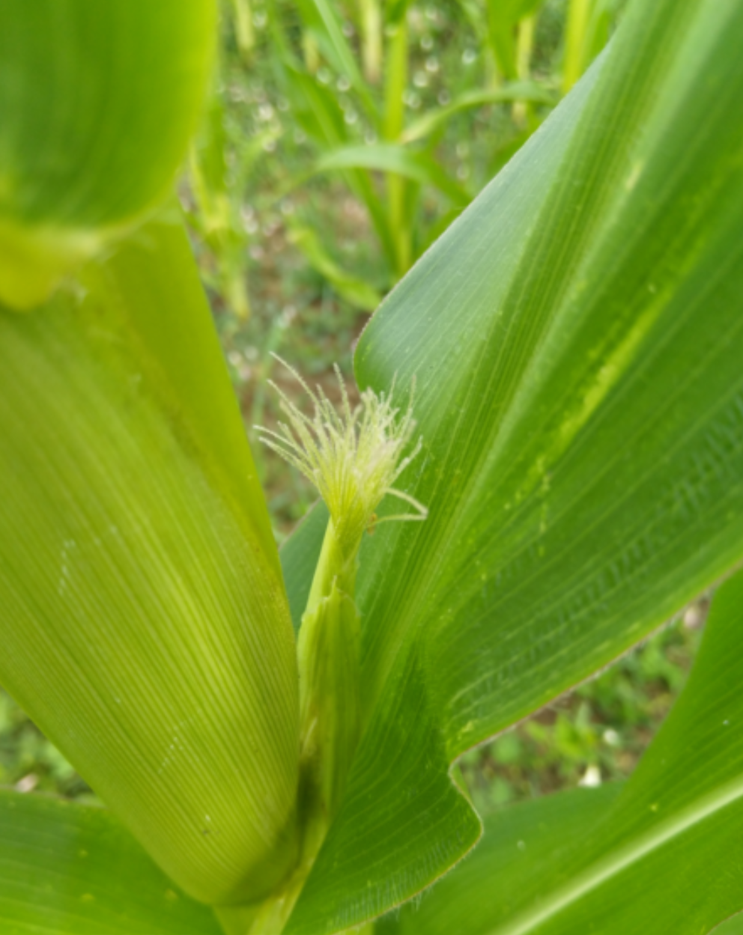
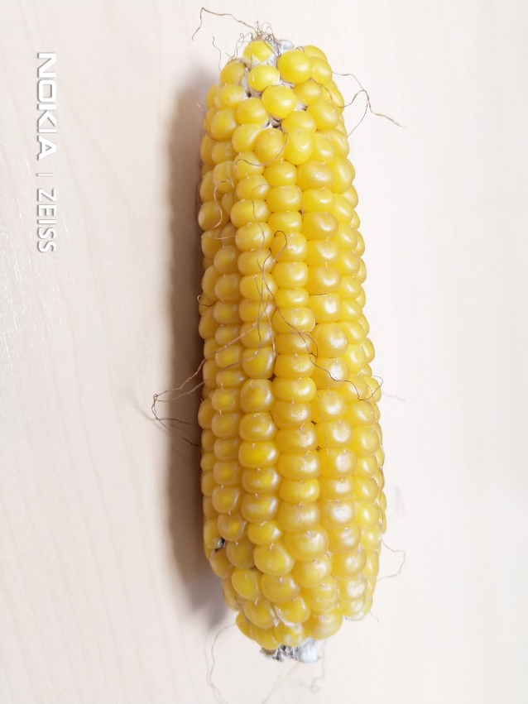
Table tells that in 25 crosses, the number of segregating QTL ‚for‘ flowering time differed. It varied from 3+1=4 until 18+6=24. We see: Flowering time is a polygenic trait.
Number and effects of QTL alleles
© WL
Onset of ‚silking‘, i.e. of female flowe-ring in maize © WL
5

Slide 6
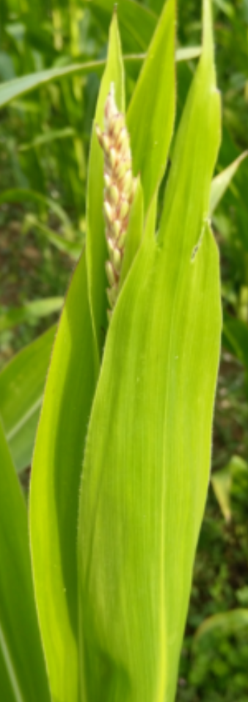
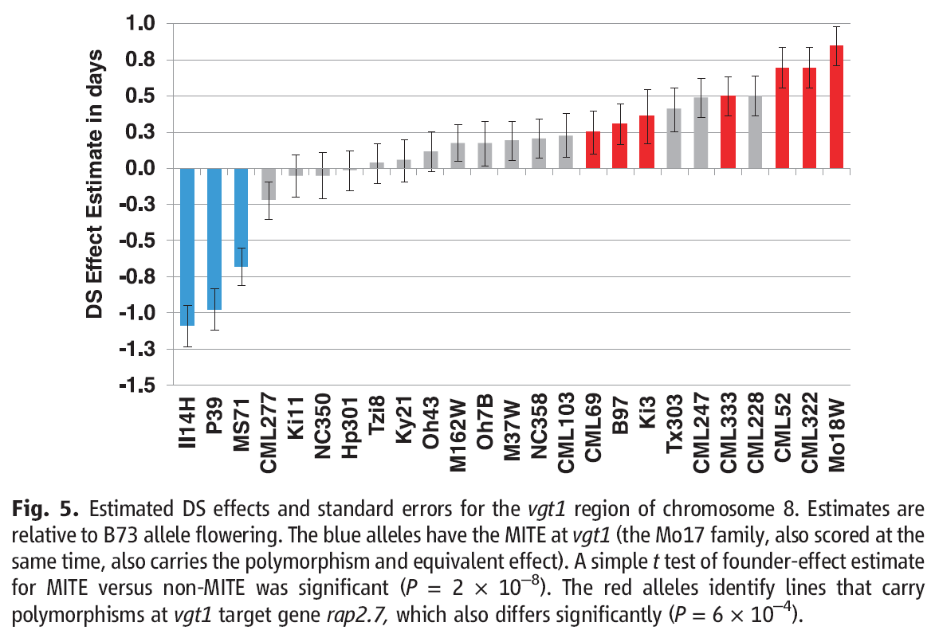
# of contributing QTL
Even such a high-heritability trait like flowering time is apparently controlled by a large number of loci and alleles!
Many alleles per locus impact the genetic segregation of one trait
Many loci jointly control the genetic segregation of one trait
6

Slide 7
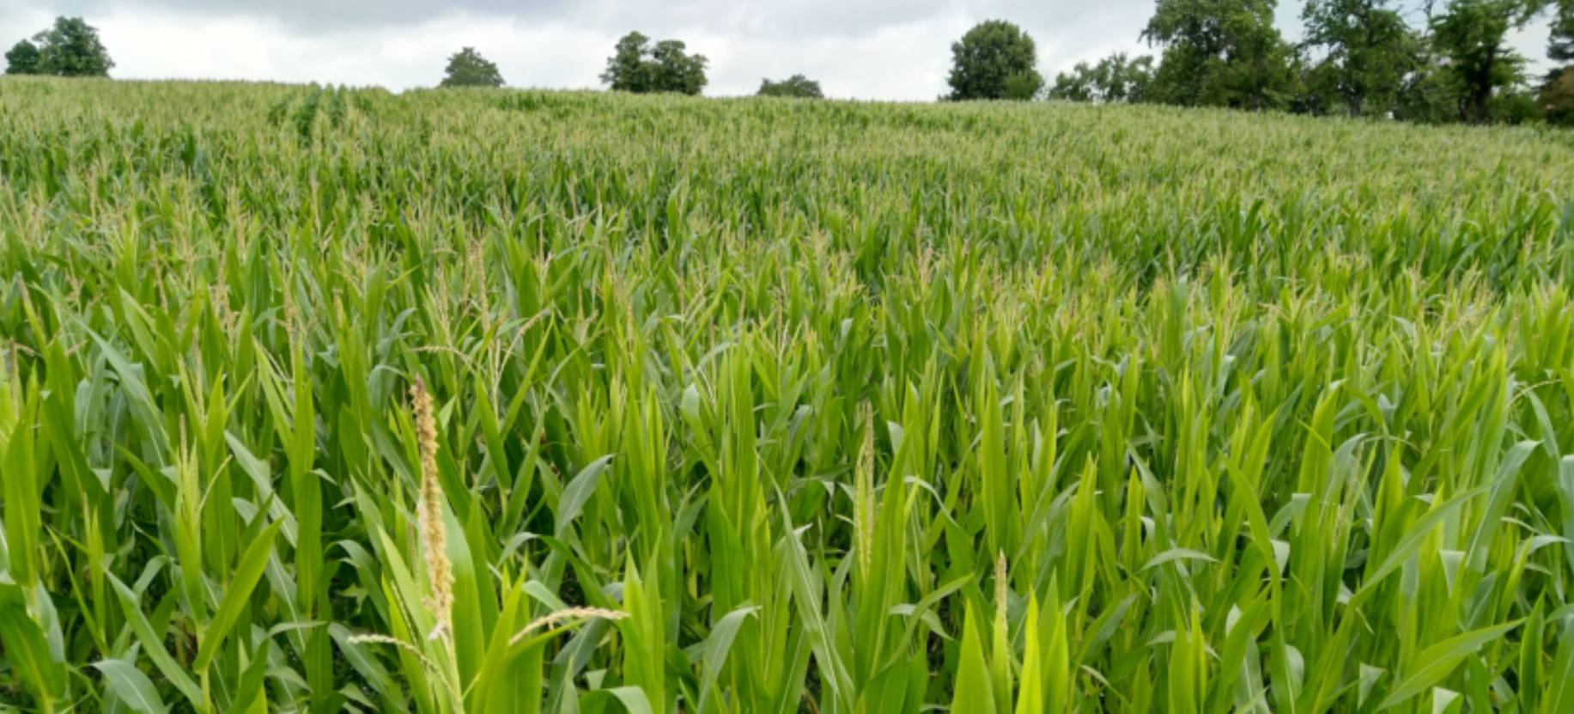
Boyle, Li, Pritchard, 2017. An Expanded view on complex traits. From polygenic to omni-genic. DX.DOI 10.1016/j.cell.2017.05.038
You know: This does not mean that the number of DNA-bits (segments-of-chromosomes; chunks-of-genome) which go through meiosis unbroken are that numerous. In maize, with 2n=2x=20, this number is about N≈23 (23, not ∞)
They say (2017): “~ all places on DNA have some
(maybe small) influence on any quantitative trait”.
Number of relevant loci is ~~ ∞
© WL
“We propose that gene regulatory networks are sufficiently interconnected such that all genes expressed in disease-relevant cells are liable to affect the functions of core disease-related genes and that most heritability can be explained by effects on genes outside core pathways. We refer to this hypothesis as an ‘‘omnigenic’’ model.”
Direct “…” citation from DOI: 10.1016/j.cell.2017.05.038
7

Slide 8
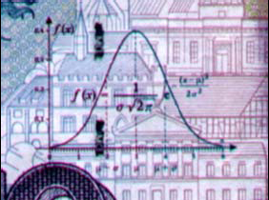
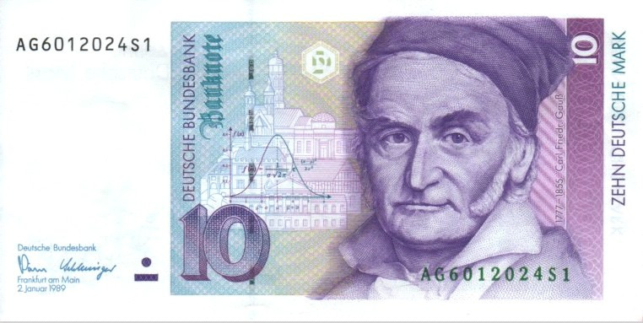
Quantitative traits are oftentimes more or less ‘normally’ distributed
8
Central Limit Theorem:
If many independent random variables are summed, their sum tends towards the normal distri-bution. Even if e.g. body height is not really the ‘sum’ of variables, it is the consequence of a high num-ber of jointly impacting factors, genes, metabolic steps, environ-mental factors such as food supply; & myriads of interactions. Body height is often rather normal distributed.
Body height is a quantitative trait.
Number of kids per family is a quantitative trait, too; but not normally distributed. Less than zero kids is not possible, and the distribution is often skewed to-wards small numbers such as 2.
Ten “Deutsche Mark“ (former German bank note, DM), showing Carl F. Gauss (1777 – 1855), who worked and taught at Göttingen; see shape and equation of the Normal Distribution. The Normal Distribution was discovered by him as one of his major contributions to Mathematics and to Science in general.

Slide 9
Quantitative traits are oftentimes more or less ‘normally’ distributed
Central Limit Theorem:
Be aware that it is not the data of a single experiment that is or be-comes normally distributed. The normal distribution arises after repeating an experiment many times, taking each experiment‘s outcome as one results, and after looking on the distribution of these many results.
A potato clone‘s starch content assessed in one experiment does not show a ‚normal‘ feature. Yet, the starch content of one or of several potato clones, if assessed across many experiments, will show variation between the clones’ and the experiments’ outcome, and this varied data then will tend to be normally distributed.
Ten “Deutsche Mark“ (former German bank note, DM), showing Carl F. Gauss (1777 – 1855), who worked and taught at Göttingen; see shape and equation of the Normal Distribution. The Normal Distribution was discovered by him as one of his major contributions to Mathematics and to Science in general.
9

Slide 10
P=G+E. Or is it rather P=µ+G+E+GE? And what does this ‘really’ say?
Physics comes with Algebraic equations such as:
U=R · I Voltage „U“ [volts] is Resistance „R“ [ohms] times Current „I“ [amps]
U=R · I el. Spannung [Volt] ist Widerstand [Ohm] mal Stromstärke [Ampere]
Correspondingly,
P = U·I Wattage „P“ [watts] is Voltage U [volts] times Currrent „I“ [amps]
P = U·I El. Leistung „P“ [Watt] ist el. Spannung U [Volt] mal Stromstärke „I“ [Ampere]
Does Biology including Genotype-to-Phenotype come which equations such as ...
P = G ∙ E Phenotype P (e.g. yield in t/ha) is Genotype „G“ [µg mRNA] times
Environment „E“ [litre of irrigated water per day] ?
No. It does not. This last equation was nonsense.
Phenotypically realized trait values can not be calculated by such equation. Biology is too complex. We can by very far not (yet) algebraically fully grasp its complexity.
We only statistically ‚explain‘ yield from several sources of variation (not causes but sources); we employ parameters such as correlations. We calculate correlations between Genes (and Genotypes) and phenotypic data; or between environmental variables [°Celsius]; [litre water] and [t/ha]. Yet, at times we too write (simplest-possible) linear equations such as 90-70=20 ☺
DOI: 10.1017/psa.2022.60
10

Slide 11
P=G+E, or is it rather P = µ + G + E + GE? And what does this ‘really’ say?
Although ‚our‘ equations can not fully ‚explain‘ the results of our breeding research, we do apply Algebra.
Here, we decompose the phenotype differences between yield data of inbred lines tested at en-vironments (results from 20 to 100); we acknow-ledge so-called ‚Sources of Variation‘: (1) Genetic (2) Environment (3) Residuals. The residual effect here mostly stays non-understood and is called GE-interaction (mind: in voltage U=R·I, there is no non-explained variation in U).
Inbred line L2 yielded on average highest (72.5). Environment E3 gave on average the highest wheat yield (67.5). The overall average was µ= 60. L1 did (on average) not deviate from this, thus its main effect was 0.0. The environment E2 was on average less fertile (compared to the average fertility of all four environments and judged from the results of these four wheats), its main effect was -5.0.
Main effects are figures (parameters, results, estimates) to which we ascribe some explanatory power – whereas interactions mainly taste and sound like „unexplained“ data noise. Yet, that depends to some extent on the case.
This way of thinking was already used in UNPLAB-h²_GxE_Ch-1[Broad Sense h²] – so here we just repeat important, already prepared knowledge ;-)
11

Slide 12
P=G+E, or is it rather P = µ + G + E + GE? And what does this ‘really’ say?
What would be the expected value Y_{L2E1} (L2 in E1; given their main effects)? Y_{L2E1} should be 60 minus 2.5 (because E1 is slightly low-fertile) plus 12.5 (because L2 is strong-yielding).
Thus, expected Y_{L2E1} = 60 - 2.5+12.5 = 70
Thus, expected Y_{L2E1} = µ + l₂ + E₁ = 70
This now … surprise … is 20 units below the actual result of Y_{L2E1} = 90.
90 – 70 = 20. The estimate for GE_{L2E1} = 20.
The below-table displays all these surprises
(all GE-interaction). In general:
GE-interaction_{LiEj} = Y_{L2E1} - µ - l_{i} - E_{j.}
In rare cases, if interactions show pattern like ‚here‘, then they still hold some information. For instance, the so far unknown wheat line L5 ob-viously ‚behaves‘ like L3 and L4 and different from L1 and L2, very probably one could find the reason for this ..
12

Slide 13
P=G+E, or is it rather P = µ + G + E + GE? And what does this ‘really’ say?
L5 obviously ‚behaves‘ just like L3 and L4 and different from L1 and L2, very probably one could find the reason for this ☺.
Solution of the riddle:
At E1 & E2, sowing was in March, at E3 & E4 in October. L1 and L2 are spring cvs. - they suffer under fall-sowing. L3 & L4 are winter cvs., they flower too late when spring sown. Judged from the GE pattern, L5 is a winter cultivar.
Be aware that such figures (main and interaction effects) are estimates.
N=4 environments and N=4 genotypes are probably too small sample to be representative for whatever ‘basic pool’ they should represent.
If this experiment was replicated (same E same L same experimental protocol), then, due to experi-mental error, the results would not be exactly the same. So: The figures are not ‚true‘ but are only best-possible approaches to the truth. They are estimates of the truth.
13

Slide 14
We genotype candidates (analyse their DNA)
We phenotype candidates (analyse their trait expression)
The result from genotyping may be a ‘haplotype’, or ‘assembly’, or ‘graphical genotype’, or ‘physical DNA sequence’, or ‘genome sequence’ ...
The result from phenotyping may be called phenotypic value of a candidate; phenotyping is usually in a concrete, tangible environments (e.g. farmer’s field).
Yet. If field tests were conducted in a representative sample of the Target Pool of Environments, then the average trait expression may be seen as estimator of the genetic value (genotypic value) of the candidate (with respect to this Target Pool).
Such genetic value is DNA-free ;-) it is calculated from phenotypic data!
The counterpart of phenotypic value is genotypic (or genetic) value.
Such genetic value is DNA-free
14

Slide 15
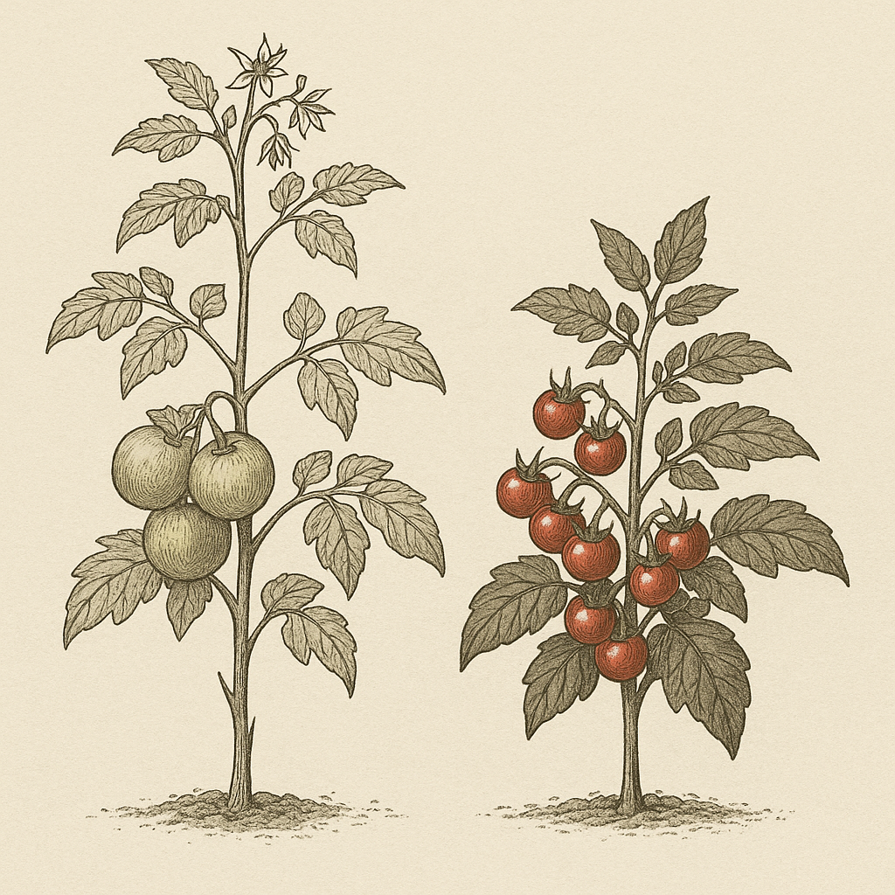
Two tomato plants with very different phenotype. The phenotypic values for fruit number, size, and colour, plant height, leaf colour, time until end of
flowering differ markedly.
Side remark. A ‘phenotype’ is the sum of observable traits and trait expressions of a plant. This term points to the mor-phology and anatomy and develop-mental pattern of a plant. ‘Phenotype’ does not tell the expression of just one trait.
The observed or measured, assessed value of one trait of a genotype in a given environmental situation then is the phenotypic value (of that trait of that genotype). So: Say ‚Phenotypic Value‘ for this.
Say phenotype if you mean it ;-)
„These phenotypes were assessed: Fruit number, size, and colour; plant height, leaf colour, and time until end of flowering”. No. ‘Phenotype’ is not synonymous to ‘Trait’ or ’Character’.
15

Slide 16
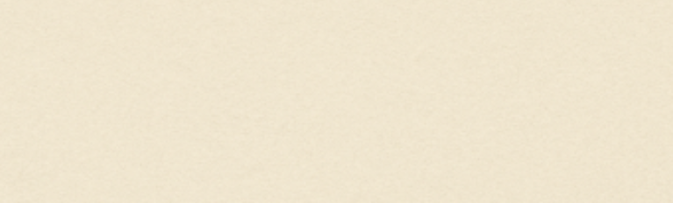

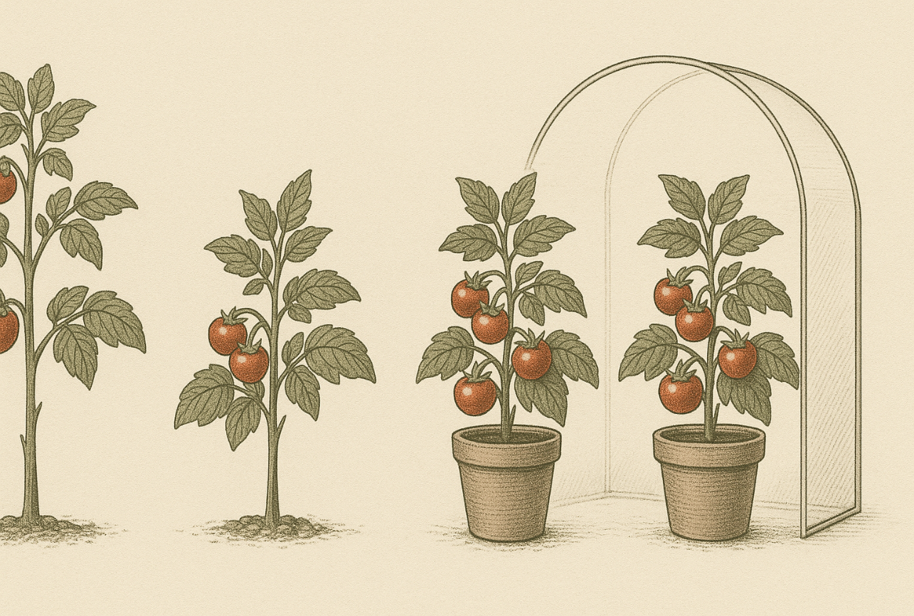

This table is directly copied from handouts of our former teacher Hartwig Geiger (Hohenheim; head of Chair of Plant Breeding and Population Genetics from 1971 - 2007).
Field condition
Greenhouse condition
A
B
A
B
For instance here: If trait differences vanish in case of controlled conditions (greenhouse), this then is grasped as ‘GxE interaction’.
20=90-[60+12.5-2.5]
16

Slide 17
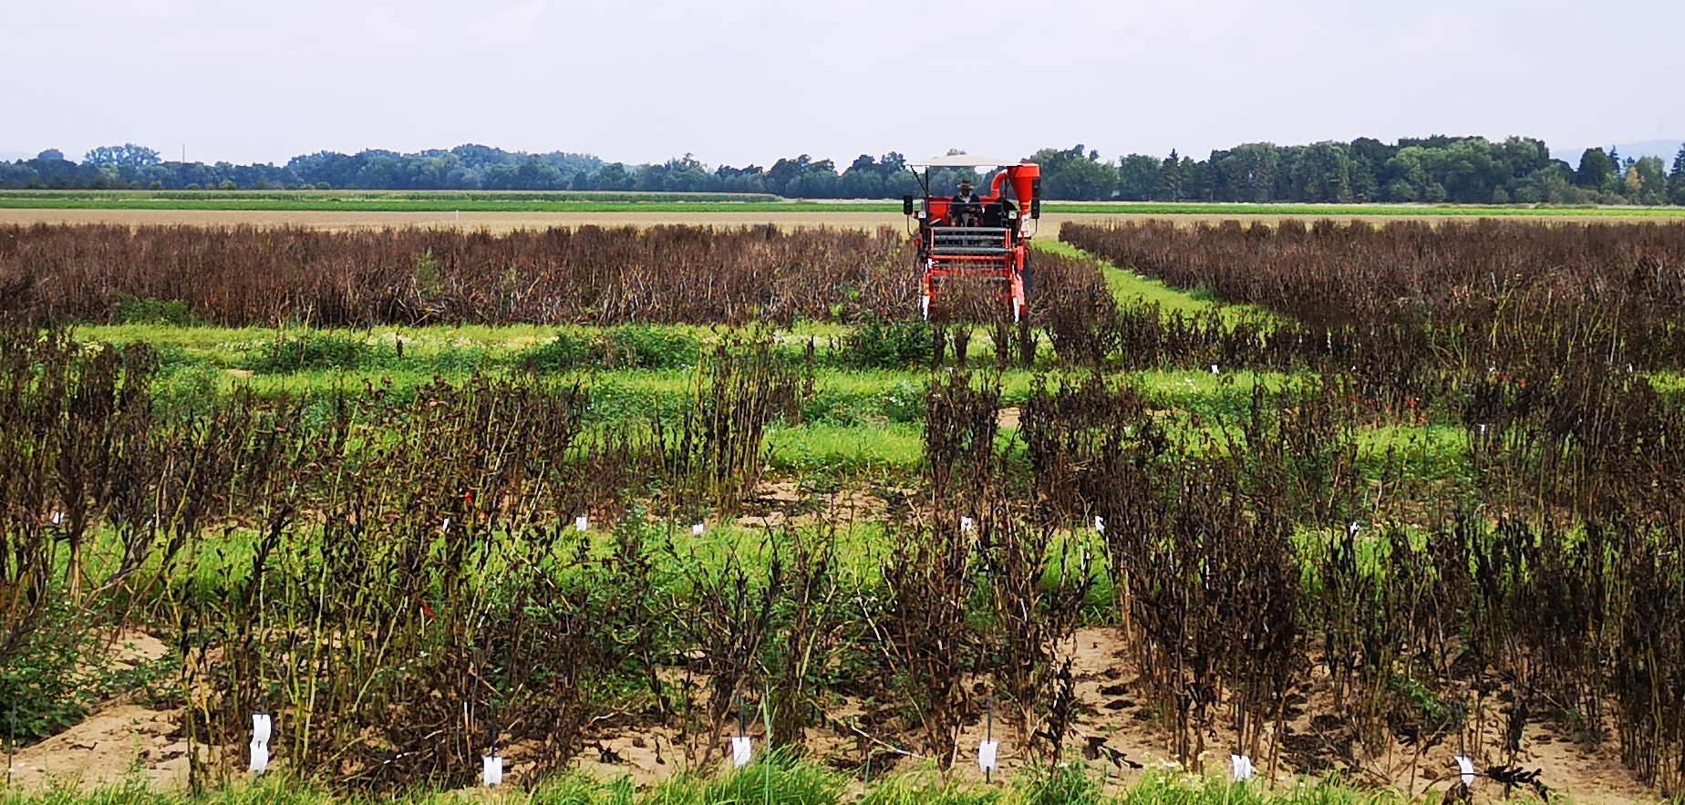
Especially the genetic variation of Grain Yield, which is oftentimes the most important trait, is influenced by the joint impact of very many loci (polygenic) with their (often more than two) alleles per locus.
© Sonja Yaman
17

Slide 18
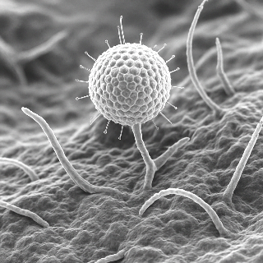
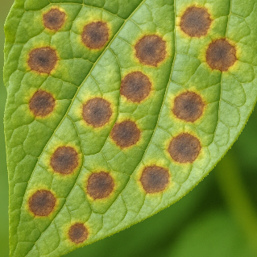
An attempt to show the genetic variation of a resistance against virus ‚V‘.
An example of a monogenic segre-gation and monogenic variation of a trait (invented, devised).
To have it less boring, we have either HWE or the once-selfed generation (S1) and we don‘t have p=q=0.5, you see it. And we have neither full domi-nance (AA=Aa) nor exactly interme-diate gene action (Aa = mean of AA and aa); but a degree of dominance
of d/a = 0.5.
There are then three clear types and you easily can find either type in the non-inbred and in the half-inbred ge-neration.
The difference between the two gene-rations in mean value (52≠46) seems unimportant.
50
1 locus
HWE µ = 52
HWE µ = 52
d/a = 0.5
S1-Gen. µ = 46
p(A) = 0.4
S1-Gen. µ = 46
40
Genotypic values:
AA =>100; Aa =>75; aa =>0
30
HWE: 16% AA; 48% Aa; 36% aa
S1: 28% AA; 24%Aa; 48% aa
Frequency (%)
20
10
0
0
10
20
30
40
50
60
70
80
90
100
Genotypic value
18

Slide 19
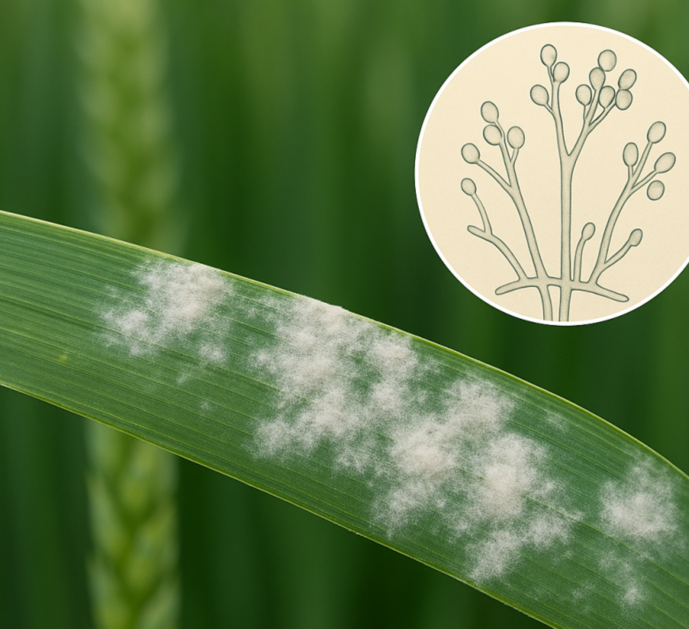
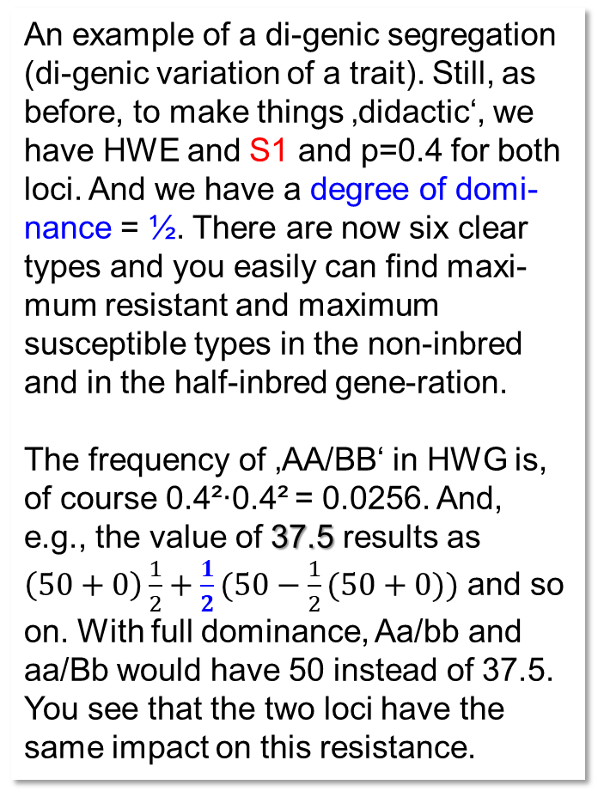
Two loci now: Take it like resistance against fungus ‚F‘.
50
An example of a di-genic segregation (di-genic variation of a trait). Still, as before, to make things ‚didactic‘, we have HWE and S1 and p=0.4 for both loci. And we have a degree of domi-nance = ½. There are now six clear types and you easily can find maxi-mum resistant and maximum susceptible types in the non-inbred and in the half-inbred gene-ration.
The frequency of ‚AA/BB‘ in HWG is, of course 0.4²∙0.4² = 0.0256. And, e.g., the value of 37.5 results as
$\left(50+0\right)\frac{1}{2}+\frac{1}{2}(50−\frac{1}{2}(50+0))$ and so on. With full dominance, Aa/bb and aa/Bb would have 50 instead of 37.5. You see that the two loci have the same impact on this resistance.
HWE µ = 52
S1-Gen. µ = 46
40
2 Loci; d/a = 0.5
p(A) = 0.4
p(B) = 0.4
LD=0
30
Frequency (%)
20
BB Bb bb
AA 100.0 87.5 50.0
10
Aa 87.5 75.0 37.5
aa 50.0 37.5 0.0
0
0
10
20
30
40
50
60
70
80
90
100
Genotypic value
The difference between the two generations (HWE and S1) in mean value (52≠46) seems still unimportant.
19

Slide 20
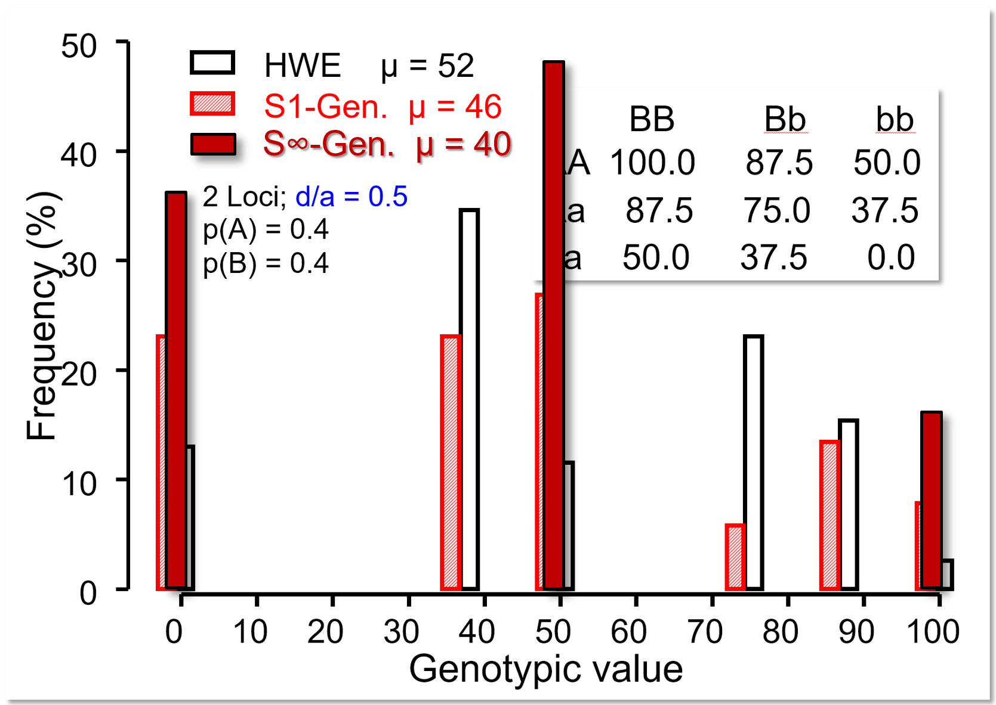
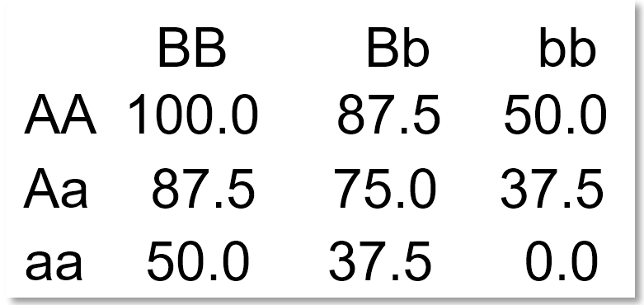
Deeper into our setting (trait) with two segregating loci, now with F=0 or F= ½ or F=1
It is very enlightening and instructive if you – yourself – find the genotype frequencies of such population, in case the population shows yet a different inbreeding coefficient (such as F=0.75). I invested time to add the case of F=1. Mind you: There is no allele frequency change, just more inbreeding ... it is as if each individual of the initial HWE population gave a representative sample of its gametes for DH production. Of course, with F=1, only double-homozygotes occur. Here, the 24% AAbb plus the 24% aaBB share the same genetic value (resistance level) at 50 units of scale (you know why, do you ... indeed, it is because both loci have the same effect).
Calculate the genetic variance in these three differently inbred generations (populations). You will find that at zero inbreeding (HWE), σ²_{G} = 798. At F=0.5, σ²_{G} = 1017, and at maximum inbreeding F=1, σ²_{G} = 1200. From a very naïve reasoning, variance at homozygosity should be double of that at HWE (here, it is not). Well, for the details, such as ‚where do the dominance effects go‘ …. we need more knowledge on Quantitative Genetics. Auf geht‘s!
20

Slide 21
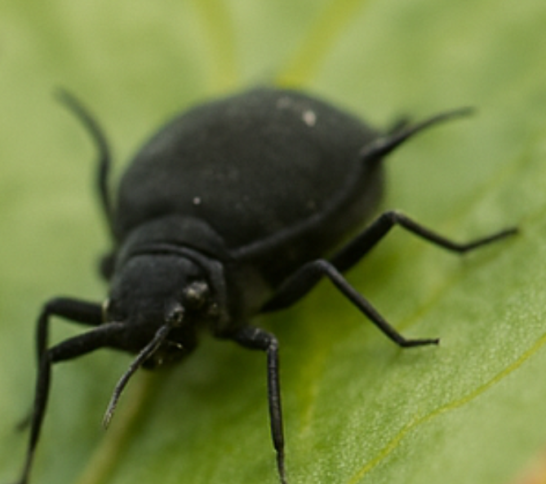
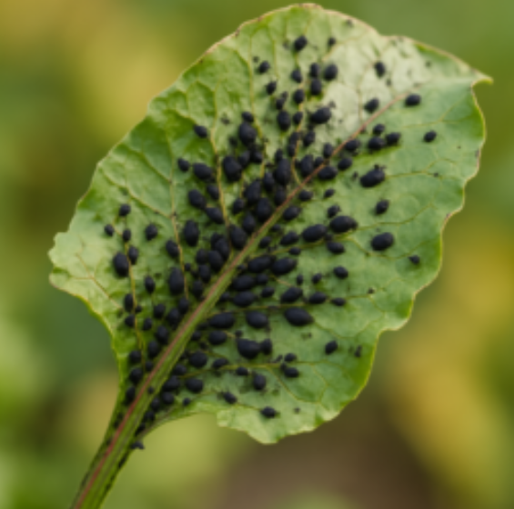
Take it like resistance against insect ‚I‘
25
4 Loci, d/a = 0.5
Now we jump across the number three and inspect a four-loci-segregation settings, all like before: HWE and S1 and, p=0.4 for all loci; degree of dominance = ½.
There are now quite many classes and types and for sure, with assess-ment error, there would be class overlap (well, here, all is with zero error, h²=1). By and by, it starts to look like ‘quantitative’. You can still find maximum resistant and maximum susceptible types – but under HWE, for instance AA/BB/CC/DD is very rare: (0.4²)⁴ = 0.0006534.
The generation mean difference
(52-46) is still not impressive.
HWE µ = 52
20
S1-Gen. µ = 46
p(A) = 0.4
p(B) = 0.4
p(C) = 0.4
p(D) = 0.4
15
Frequency (%)
10
5
0
0
10
20
30
40
50
60
70
80
90
100
Genotypic value
21
A red and a black column share a common value such as 0.0, although drawn side by side …

Slide 22
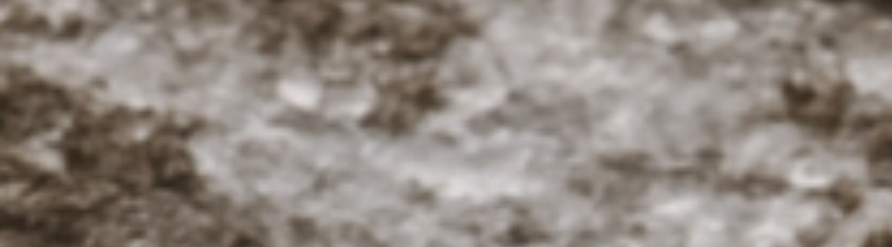
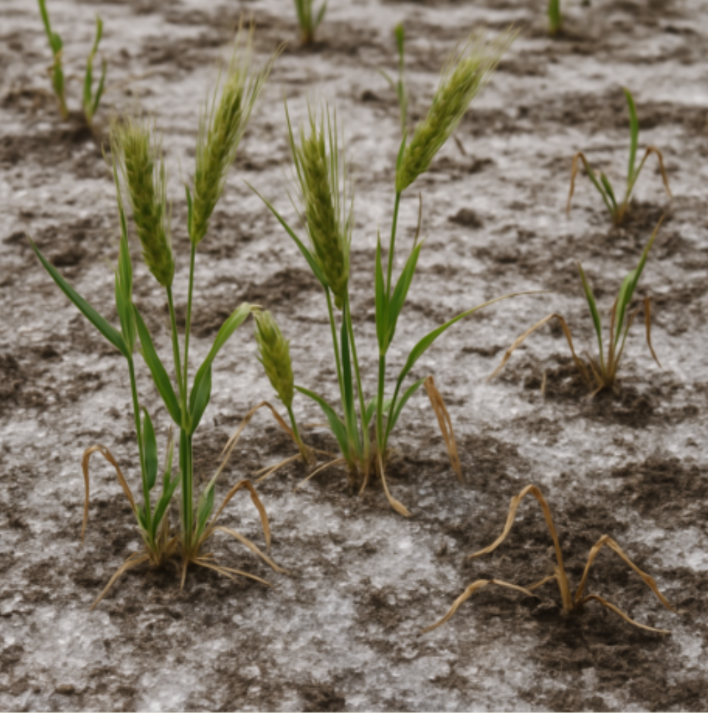
Take it like resistance or tolerance in case of salt stress
22
10 Loci; d/a = 0.5
p(A) = 0.4
et cetera
Now: Ten loci, still the same basic ‚rules‘.
I was not patient enough to draw all the many classes. Instead, you see the approximation of them by the Normal Distribution.
By the way: Should we rather emphasize “LD=0” or rather that the “loci are all pairwise unlinked”? Visit again UNPLAB-PopGen_Ch-9 until UNPLAB-PopGen_Ch-11 ;-)
S1-Gen. µ = 46
HWE µ = 52
The probability to find a genetically mini-mum or maximum tolerant genotype is extremely low, as you see. For instance, in case of HWE, the figures are 0.4²⁰ and 0.6²⁰ - use your own table calculator ;-)
By the way:
The generation mean difference (52-46) is ‘still’ not impressive.
0
0
10
20
30
40
50
60
70
80
90
100
Genotypic value for salt stress tolerance

Slide 23
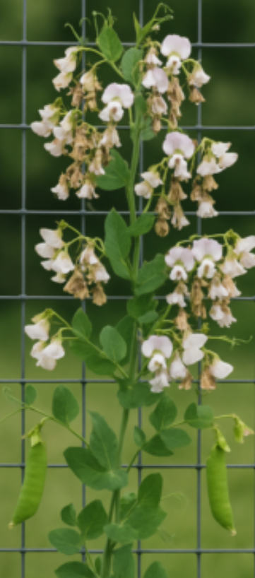
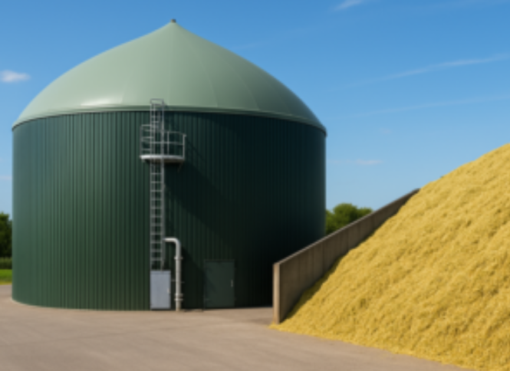
HWG µ = 52
Left: Ratio of seeds per flower. Right: Biogas yield. Both very much quantitative traits.
“LD=0” would be the better statement
100 Loci; d/a = 0.5
p(A) = 0.4
1000 Loci; d/a = 0.5
p(A) = 0.4
S1-Gen. µ = 46
HWE µ = 52
S1-Gen. µ = 46
HWE µ = 52
0
10
20
30
40
50
60
70
80
90
100
0
10
20
30
40
50
60
70
80
90
100
Genotypic value
Genotypic value
With very many segregating loci (all pairwise LD=0), the variance shrinks: The larger the sample of loci and alleles (randomly taken from the basic pool), the more each genotype is a very representative realization of the mean of that pool and rarely an outlying (outstanding) genotype (such as one with very many good or with very many bad alleles). Meanwhile, the difference between the generations counts, the relatively higher performing ones are more frequently found in HWE than in the half-inbred version of that population. Dominance, although only d/a=0.5, starts to make a difference.
23

Slide 24
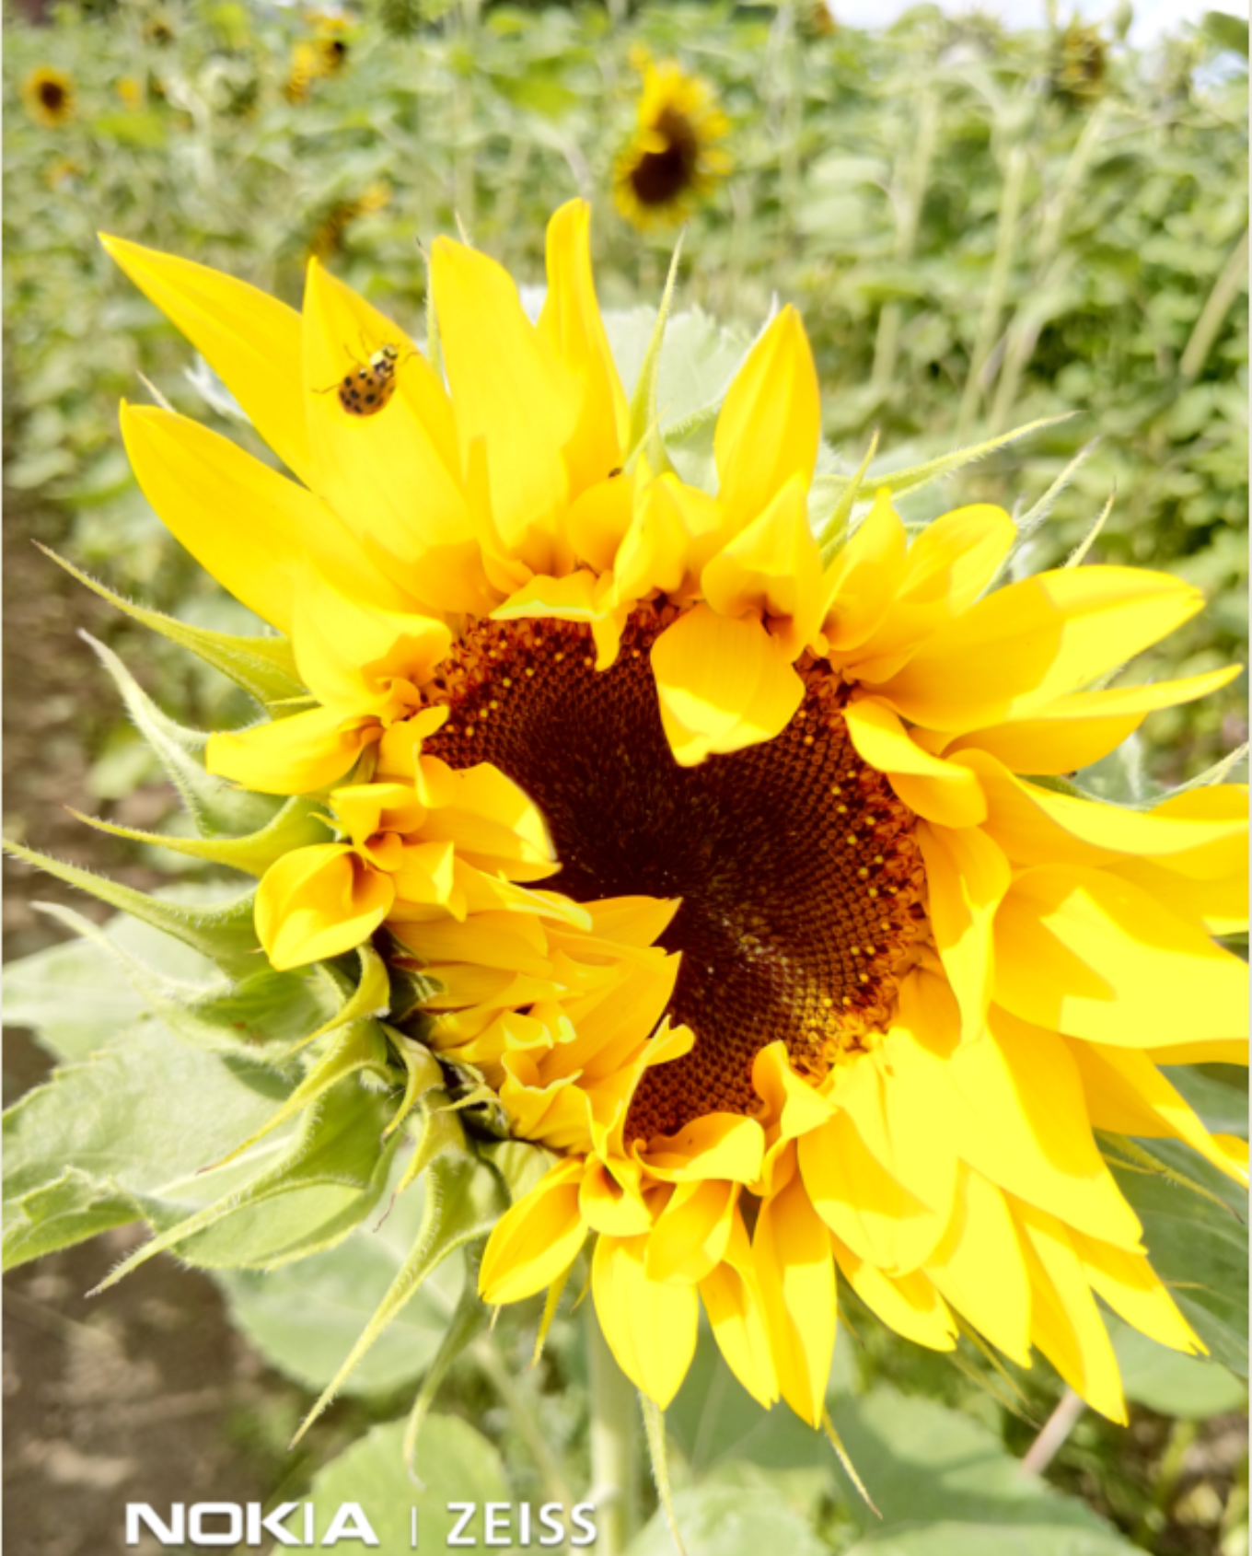
HWG µ = 52
Really?
Heliantus annuus, sunflower. Take it as symbol of light;
of Enlightenment.
24
100 Loci; d/a = 0.5
p(A) = 0.4
1000 Loci; d/a = 0.5
p(A) = 0.4
S1-Gen. µ = 46
HWE µ = 52
S1-Gen. µ = 46
HWE µ = 52
0
10
20
30
40
50
60
70
80
90
100
0
10
20
30
40
50
60
70
80
90
100
Genotypic value
Genotypic value
Genetics is (1) the way from the DNA via tRNA across biochemistry and physiology up-to-the phenotype (with gene action and Michaelis Menten et cetera). And: Genetics is (2) the way of genes on chromosomes from parents to offspring (cloning, selfing, crossing; meiosis & recombination). 100 or 1000 loci may be true in (1), a very high number of genes, loci and alleles, may jointly impact the ‘making’ of a trait. But our topic here ...
© W. Link
… genetic variance, is ‘made’ by transmitting differences between gametes into the next generation (gametes created by a focal genotype through its meiosis). See maize (2n=2x=2∙10) with ~ 23 segments-of-chromosome that go unbroken through meiosis. Assume General HWE and LD=0 and no linkage. Will the genetic variation become smaller with increasing number of genes in the sense of (1) or is the much lower number (2) of intact chromosome-segments per meiosis (e.g. N=23) limiting this shrinkage of variance? It is now you to think – you, my dear expert ;-)

Slide 25
From here you may go to UNPLAB-QuGen_Ch-3[Transition II]
25
Open your heart and mind and think with me! If LD=0, then each and all haplotypes occurs at the frequency expected from allele frequencies of all loci involved.
Well. It is not easy to picture how LD=0 could ever truly hold — that is, for all loci and in every pairwise comparison. And yet, this is exactly what we assume.
One would need a long history of random mating, undisturbed by drift, selection, mutation, migration, and without complete linkage. Under such conditions, perhaps such a state might emerge.
And suppose LD=0 does hold - is reached. From that moment on, even complete linkage would not, by itself, alter the situation. Linkage alone does not create LD > 0; it merely (tries to) preserves what is already there. It shields the status quo from recombinational decay.
If the status quo is LD = 0, then linkage simply maintains LD = 0.
So: With LD = 0, the number of unbroken chromosome segments is not relevant. With LD = 0, it is (as to variance) as if we had as many such segments (unlinked) as we have loci.

